Slide 1

Computer Engineering Department A.P. Shah Institute of Technology G.B.Road, Kasarvadavli, Thane(W), Mumbai-400615. UNIVERSITY OF MUMBAI Academic Year 2021-2022

Slide 2
Synopsis on Handwritten Text Recognition Submitted in partial fulfillment of the degree of Bachelor of Engineering (Sem-6) in Computer Engineering By Avishkar Dalvi (20202002) Riddhi Narkar (19102003)
Soumyojyoti Dutta (19102014)
Vedang Gore (19102065)
Under the Guidance of Prof. Deepali Kayande

Slide 3
1.Project Conception and Initiation

Slide 4
1.1 Abstract
Handwritten Text Recognition (HTR) is a very important field of research in the domain of Machine Learning, Image processing, and Artificial Intelligence. This is because it often involves decoding human written letters and words in a specific language. This project involves recognition of individual words. We are using ANN (artificial neural network) as it mimics the biological functioning of the brain, and hence is very efficient according to research for this problem statement. We used a Kaggle dataset with 4L transcripted images of names written in capital letters. This is a comparative study by using 4 different activation functions and by keeping the model, algorithm and dataset fixed.

Slide 5
1.2 Objective and Scope
The objective of this research project is to fix the ML model and algorithm and dataset and change activation functions to get a comparison between these different activation functions. The functions we considered are ‘sigmoid’, ‘selu’, ‘elu’, and ‘relu’.
The dataset we used was sourced from Kaggle and contains transcriptions of 400,000 handwritten names.
This project is to developed on validating handwritten words. So it is on the second level of handwritten text recognition.

Slide 6
1.3 Literature Review
Research papers | Year Published | Authors | Abstract
Handwritten Optical Character Recognition (OCR): A Comprehensive Systematic Literature Review (SLR) | 2020 | Jamshed Menon, Maira Sami, Rizwan Ahmed Khan, Mueen Uddin | During last decade, researchers have used AI/ML tools to automatically analyze handwritten and printed documents in order to convert them into electronic format. The objective of this review paper is to summarize research that has been conducted on character recognition of handwritten documents and to provide research directions.
Handwritten Text Recognition in Historical Documents | 2018 | Harad Scheidl, Robert Sablatnig | HTR is an automatic way to transcribe documents by a computer. The proposed system is based on ANN, i.e. Artificial Neural Networks.
.

Slide 7
1.3 Literature Review
Handwritten Text Recognition System based on Neural Network | 2016 | Ahmed Mahi Obaid, IIHazem M. El Bakry, IIIM.A. Eldosuky, IVA.I. Shehab | Handwritten text recognition is still an open research issue in the domain of Optical Character Recognition (OCR). This paper proposes an efficient approach towards the development of handwritten text recognition systems. 3-layer Artificial Neural Network (ANN) is utilized in this Paper using supervised learning approach.
Handwritten Character Recognition in English: A Survey | 2015 | Monica Patel, Shital Thakkar | This paper presents a comprehensive review of Handwritten Character Recognition (HCR) in English language. The handwritten character recognition has been applied in variety of applications like Banking sectors, Health care industries and many such organizations where handwritten documents are dealt with.

Slide 8
1.4 Problem Definition
Writing has been an ancient form of art as well as the main medium for written communication throughout history. With the advent of digital media, however, it seems to change.
A lot of people often face slight inconveniences, when they need a text format of a piece of writing. The only possible way out here is to manually type out the information on a digital medium to use it in the digital form.
Our mini project tries to research on the methods which do this efficiently.

Slide 9
1.5 Technology stack
Python
Tensorflow
Keras
Flask

Slide 10
2. Project Design

Slide 11
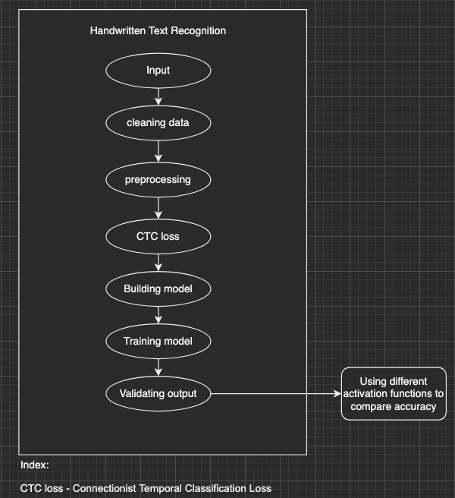
2.1 Design of Modules

Slide 12
2.2 Description Of Modules
INPUT
We take input in the form of images.
CLEANING DATA
A lot of these images may be null, or unreadable. In this stage, we remove such images.
PREPROCESSING
We need to make all the data uniform so that the model can train on it. Here we set the dimensions and crop the image if it is larger, or pad it with white pixels if it is smaller.

Slide 13
2.2 Description Of Modules
BUILDING MODEL
Here is where we add the layers and build the model. We built a CRNN model. (Convolution Recurrent Neural Network)
TRAINING MODEL
Here we train model on the training set.
PREDICTIONS
Based on the model, we predict the result.

Slide 14
3. Implementation

Slide 15
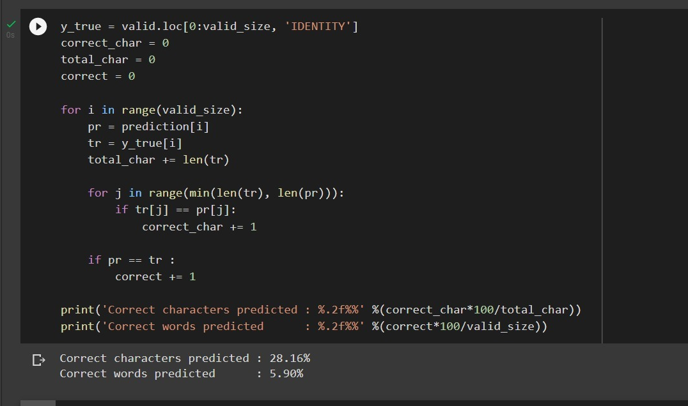
3.1 Execution
Sigmoid Activation function:

Slide 16
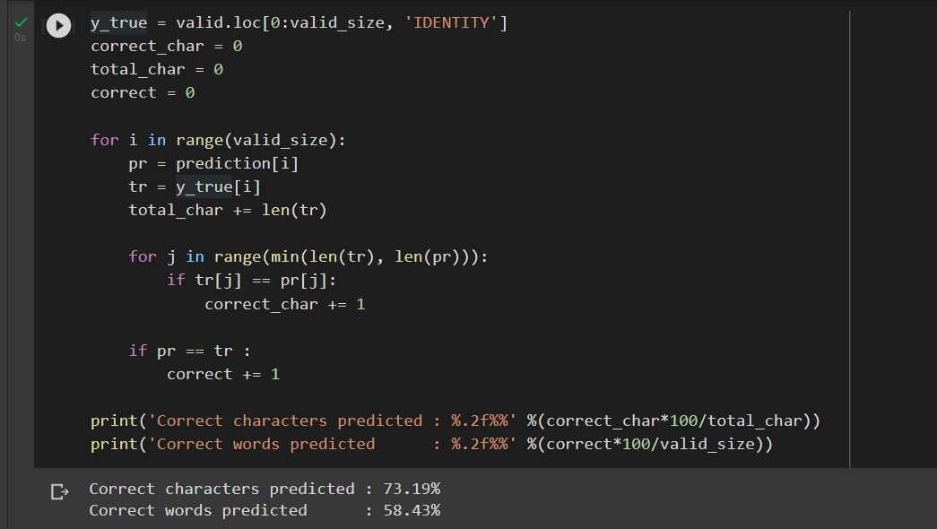
3.1 Execution
Elu Activation function:

Slide 17
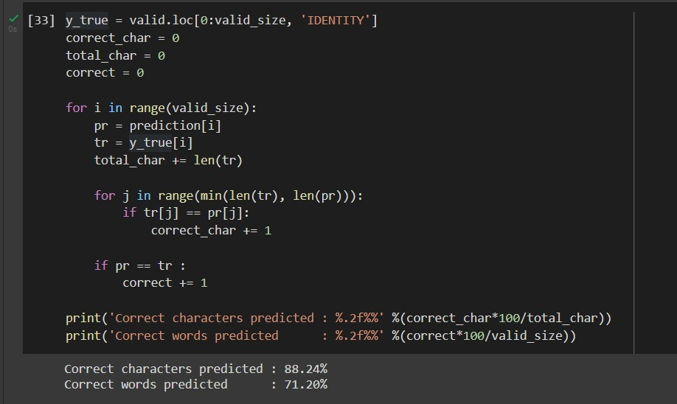
3.1 Execution
Selu Activation function:

Slide 18
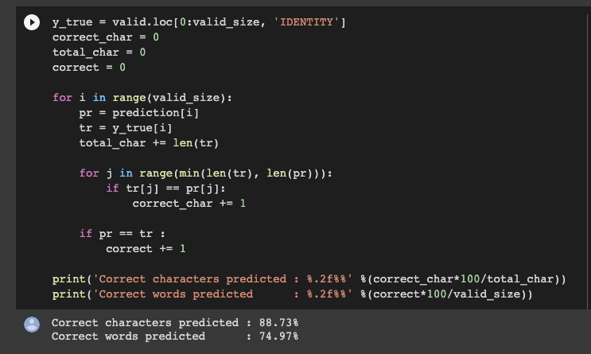
3.1 Execution
Relu Activation function:

Slide 19
3.2 Result
Sigmoid, Selu, Elu, and Relu all 4 of these activation functions gave us different accuracies which are summarized with the help of a table below.
Sr. No. | Activation Function | Accuracy
1) | Sigmoid | 5.90%
2) | Elu | 58.43%
3) | Selu | 71.20%
4) | Relu | 74.97%

Slide 20
3.3 Conclusion
On the basis of this comparative study, we thus conclude that for a fixed dataset consisting of 4,00,000 transcripted images of uppercase handwriting, and using the CRNN model with CTC loss, we were able to achieve the highest accuracy of 74.97% with the activation function of relu, opposed to three other activation functions - selu, sigmoid and elu.
Thus, relu can be a preferred activation function choice when trying to solve a similar problem under the domain of handwritten text recognition.

Slide 21
3.4 References
[1] ﻿ Fathma Siddique, Shadman Sakib, Md. Abu Bakr Siddique, “﻿Recognition of Handwritten Digit using Convolutional Neural Network in Python with Tensorflow and Comparison of Performance for Various Hidden Layers”, ﻿International University of Business Agriculture and Technology, Dhaka 1230, Bangladesh.
[2] Harald Scheidl, 2018, “Handwritten Text Recognition in Historical Documents,” Technische Universität Wien.
[3] Jamshed Memon¹, Maira Sami², Rizwan Ahmed Khan³ and Mueen Uddin⁴, 2020, “﻿Handwritten Optical Character Recognition (OCR): A Comprehensive Systematic Literature Review (SLR)”, ¹School of Computing, Quest International University Perak, Ipoh 30250, Malaysia, ²Department of Computer Science, Shaheed Zulfiqar Ali Bhutto Institute of Science and Technology, Karachi 75600, Pakistan, ³Faculty of IT, Barrett Hodgson University, Karachi 74900, Pakistan, ⁴Department of Software Engineering, Faculty of Science and Technology, Ilma University, Karachi 75190, Pakistan.
[4] Shivangkumar R. Patel, ﻿Ms. Jasmine Jha, “﻿Handwritten Character Recognition using Machine Learning Approach - A Survey”, ﻿ from L.J.I.E.T. PG Department Ahmedabad, Gujarat – India, ﻿presented in International Conference on Electrical, Electronics, Signals, Communication and Optimization (EESCO) – 2015.
﻿
﻿

Slide 22
3.4 References
[5] Rohan Vaidya, Darshan Trivedi, Sagar Satra, “﻿Handwritten Character Recognition Using Deep-Learning” ﻿Dwarkadas J Sanghvi College of Engineering, Mumbai, India, ﻿Proceedings of the 2nd International Conference on Inventive Communication and Computational Technologies (ICICCT 2018) IEEE Xplore Compliant - Part Number: CFP18BAC-ART; ISBN:978-1-5386-1974-2.
﻿[6] Monica Patel, Shital P. Thakkar, ﻿“ ﻿Handwritten Character Recognition in English: A Survey”, Department of Electronics and Communication, Dharmsinh Desai University, Nadiad, Gujarat, India, ﻿International Journal of Advanced Research in Computer and Communication Engineering Vol. 4, Issue 2, February 2015.
﻿[7] Ahmed Mahi Obaid¹, Hazem M. El Bakry², M.A. Eldosuky³, A.I. Shehab⁴, “﻿Handwritten Text Recognition System Based on Neural Network”, Dept. Information Systems^{1, 2, 4}, Dept. Computer Science³ Faculty of Computer Science and Information Systems, Mansoura University^{1, 2, 3, 4}, Mansoura, Egypt, International Journal of Advanced Research in Computer Science & Technology (IJARCST 2016) 72 Vol. 4, Issue 1 (Jan. - Mar. 2016).
﻿

Slide 23
Thank You

